Slide 1

ROOF FEDERATION
PROJECT -- “Water for Life”

Slide 2

INTRODUCTION
Founded in 2022, Roof Federation was born from the vision of a young social entrepreneur NIKHIL TYAGI who brought together a group of passionate, like-minded individuals committed to PROVIDE SUSTANIBILITY GOALS.
restoring and cleaning waste water through bio-remedies and eco-friendly techniques, ensuring safe water for people and communities. To Fulfil his dream of providing sustainability goals. Nikhil Tyagi has been associated with the cause since 2017.
We work with a clear purpose: to build a society where every child receives love and education, where women are empowered to lead independent, dignified lives.
Our NGO has undertaken several initiatives to address water scarcity, promote sustainability, and ensure safe drinking water in underserved communities by initiating “Breath for life” project.
promoting sustainable practices, spreading awareness, and taking action to protect nature and build a healthier planet.
restoring and cleaning waste water through bio-remedies and eco-friendly techniques, ensuring safe water for people and communities.
.

Slide 3

PRODUCT RESEARCH AND DEVELOPMENT DEPARTMENT Ballabhgarh - Haryana
Our team of expert scientists
We undertakes feasibility studies under laboratory conditions and also at field level and suggests algal technology to treat the effluent. With over 40 Plus Years of Experience expert team in Micro Algae Technology and 12 Years in Algae Utilization in Effluent Treatment
BEST REVIEWER AWARD 2014
At Roof Federation, our dream is bigger than just offering support — it’s about giving every individual the security of a roof over their head and the hope of a brighter future. Together, we are building a world where compassion, opportunity, and empowerment are the foundation of society

Slide 4

Bio Remediation of Waste Water
Bio Remediation of Waste Water
It is our pleasure to inform you that “ROOF FEDERATION” is engaged in the treatment and remediation of polluted water bodies like lakes as well as with numerous industry segments like Chemical, Agrochemical, Leather, Pharmaceutical Intermediate, Textile and Electroplating. The research and application group, with experience of more than a decade and the practical experience which the group has gained based on application of Bioremediation in industrial waste water which were earlier considered untreatable through biological means.
Our technology makes use of well researched and customized Micro – Algae Consortia and nutrition and growth hormones to treat Eutrophication and pollution in Water bodies. We may like to confirm that we use No Toxic and Inorganic Chemicals. Our products are 100% environment friendly and organic which promote biotic life like Zoo Planktons, Fish etc.

Slide 5

Algae based Bioremediation is known as PhyCoremediation
PhyCoremediation is defined as the use of either macro-algae or micro-algae (Using Sun Light and Carbon Di Oxide) for the removal or biotransformation of pollutants, including nutrients and Xenobiotic from Waste Water.
Green Micro-Algae carries out Photosynthesis using Sun Light and absorbing Carbon Di-Oxide
We use green micro- algae for Purification of the Air & Water and reducing Carbon Foot Prints

Slide 6

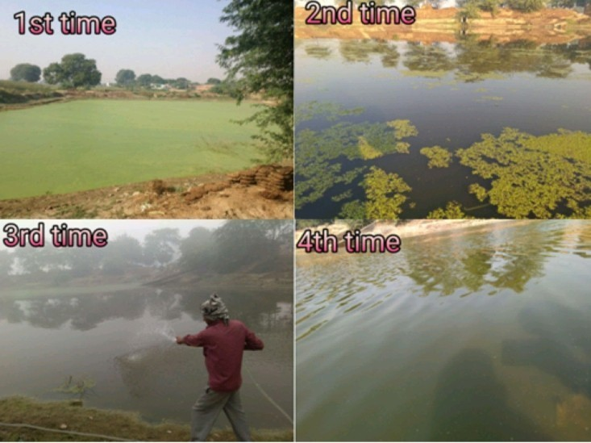
Our team will conduct a thorough analysis of the effluent/ river / lake and will identify the select strains of micro-algae that are capable of growing and remediating these streams. Simultaneously, the micro-nutrients have been identified that will be able to trigger the growth of a healthy “micro-algae – bacteria” consortium in the canals. Micro-algae never survive on their own. They are always associated in a symbiotic relationship with a host of bacterial species. Our technology lies in identifying the right combination of micro-algae, bacteria and micronutrient combine that can give the best optimized solution for a particular problem.
    A stabilized culture of isolated micro-algae – bacteria consortium will be grown and developed at our manufacturing facility.
    Injection points will be wherein our select consortia as well as the micro-nutrients will be sprayed on a continuous basis.
    Nutrients – a mixture of nutrients and robust algae species will be diluted and sprayed on a continuous basis.

Slide 7


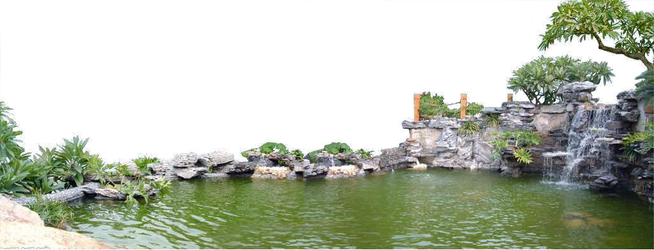
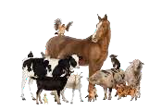

MAJOR KEY FACTORS OF
MICRO ALGAE BIOREMEDIATION TECHNOLOGY
Environment will be Oxygen Rich
Algae Bloom, Water weeds & hyacinth will stop growing. Fishes become more active
No foul smell at all - 100% removal
Animals & Birds will start drinking water
Mosquitoes will be reduced

Slide 8
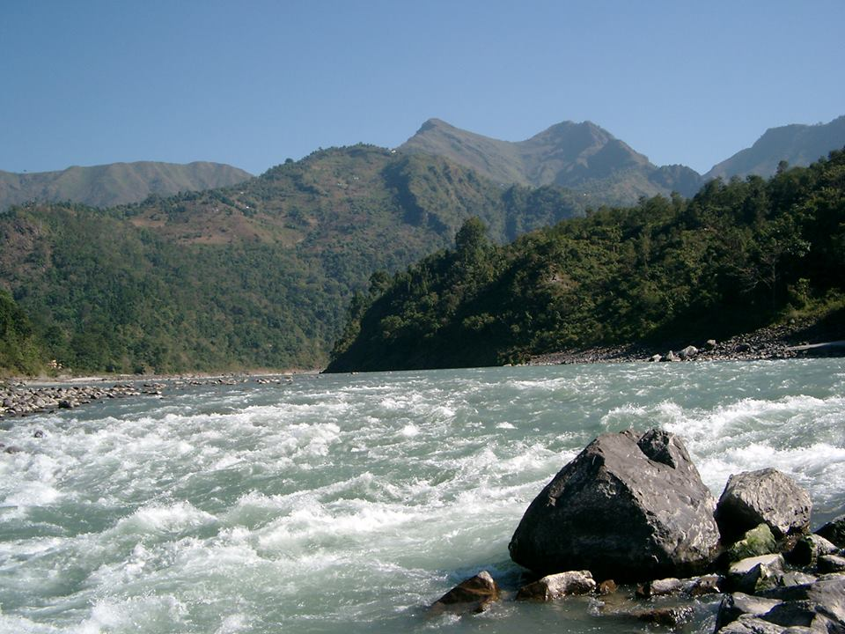
Micro Algae can be compared to Micro-aquatic plants
Algae keeps Ganga , Yamuna , and other Rivers/water bodies relatively clean in spite of heavy pollution
Presence of Algae in Water Bio oxygenate the medium and absorbs excess nutrition

Slide 9

Comparison
Trees/Plants Versus Micro-Algae
As trees purify air , Algae purifies Water
PLANTS ALGAE
Takes years to Grow Takes Hours/days to grow
Does transpiration Algae do transpiration
Needs Nitrates /Phosphates other Also needs Nitrates/Phosphates /other nutrition to grow nutrition to grow
Produces roots, Leaves, stem etc. while growing Does not produce leaves/roots etc.
Multiplication of cell is very slow Multiplication of cell takes place at
very fast rate
Cannot tolerate harsh conditions Can tolerate very harsh conditions

Slide 10

What Algae does to protect Environment
( Water and Air)
Bio Oxygenation
Absorbing Excess Nutrition from Waste Water
ALGAE Works ON SUN LIGHT
Micro Algae Consortia
Elimination of Foul smell
Promoting Aerobic bacteria
Absorption of CO2
ALAGE WORKS ON LED ASWELL
Sets up Natural
Food Chain

Slide 11

Algae for Waste water Treatment
Reduction of parameters by PhyCoremediation
45%
65%
70%
85%
94%
95%
97%
95%
96%
97%
pH - Stabilizes towards Neutral -7.0
There is increase in Dissolved Oxygen Level

Slide 12

Algae helps to reduce heavy metals
By using select S .salina almost 60% Cr, 66% Fe, 70% Ni, 77% Hg, 65% Ca2+, 63% Mg2+ and 78% of total hardness was reduced in 15 days of treatment

Slide 13
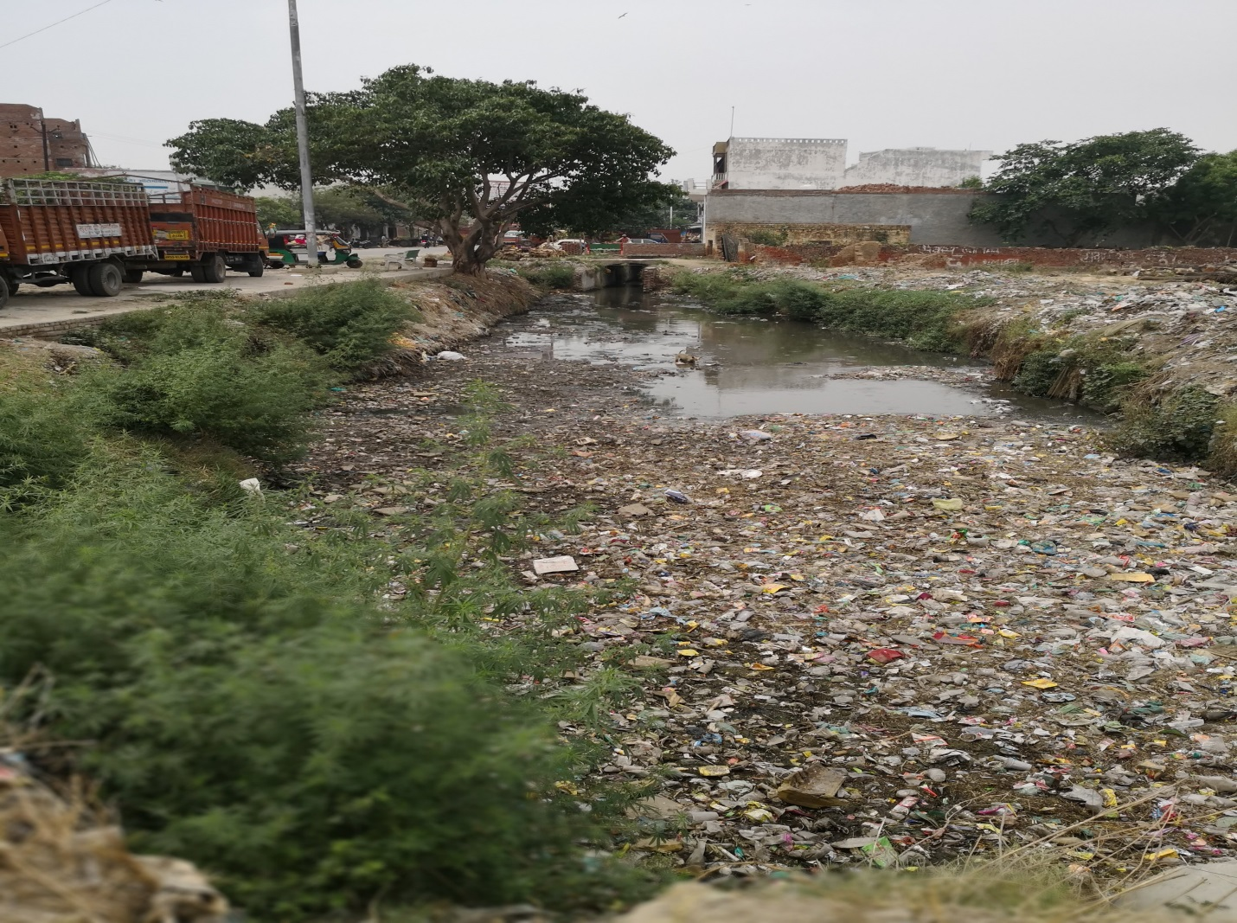
Our broad areas of operation
Dairy Farms
Fish Farms
Sugar Mills
Paper Mills
Breweries
Distilleries
Food Processing
Refineries
Chemical Units
Tanneries
Dyeing Industries
Engineering
Electroplating
Domestic Sewage
Slaughter House
Drains
Rivers
Lakes
Ponds

Slide 14

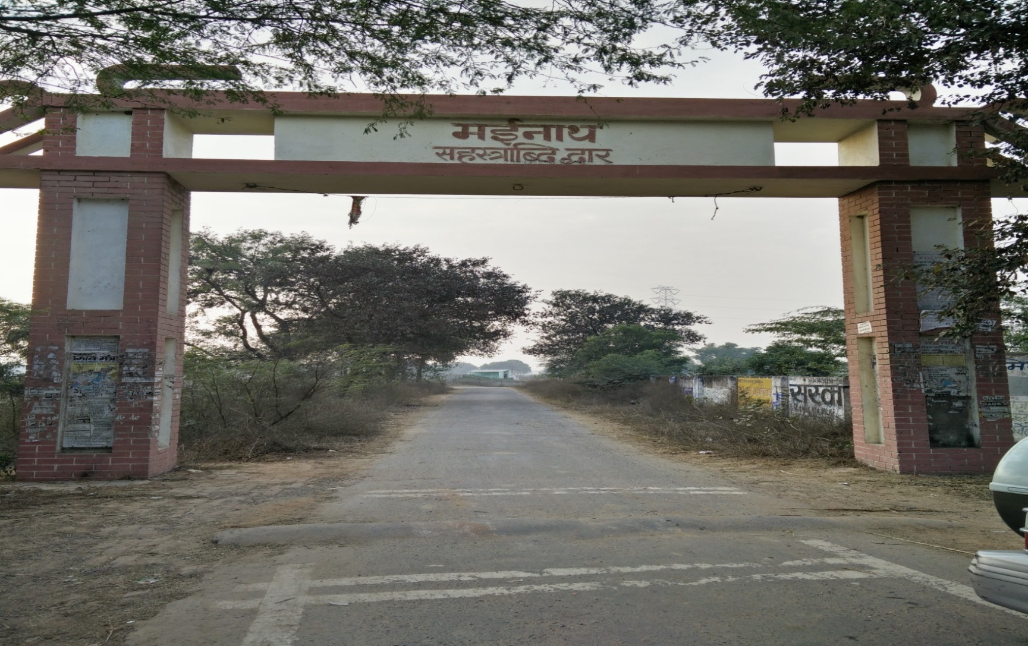
Our Experiences
PROJECT “WATER FOR LIFE”
Polluted Pond at Mainath Village – Near Aligarh

Slide 15

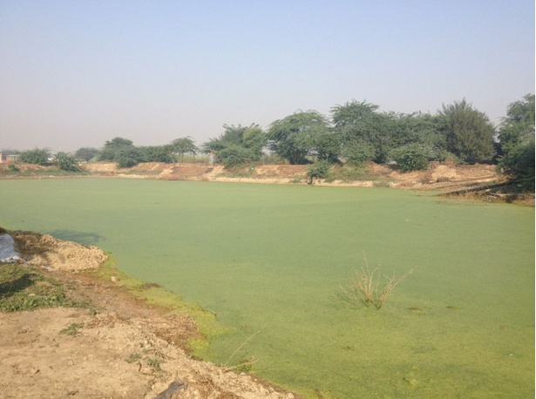
Initial condition of the Pond
It was laden with Duckweed / Cyanobacteria and having stinking smell

Slide 16


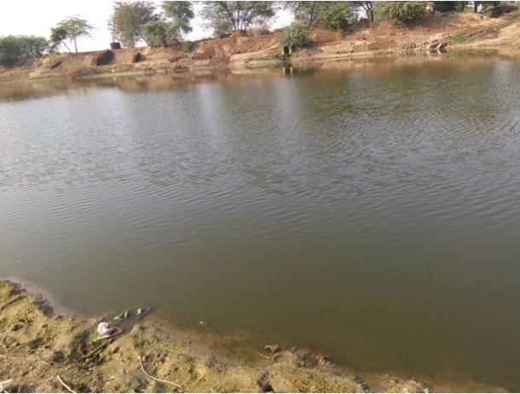
Changing condition of the Pond
Final condition of the Pond

Slide 17

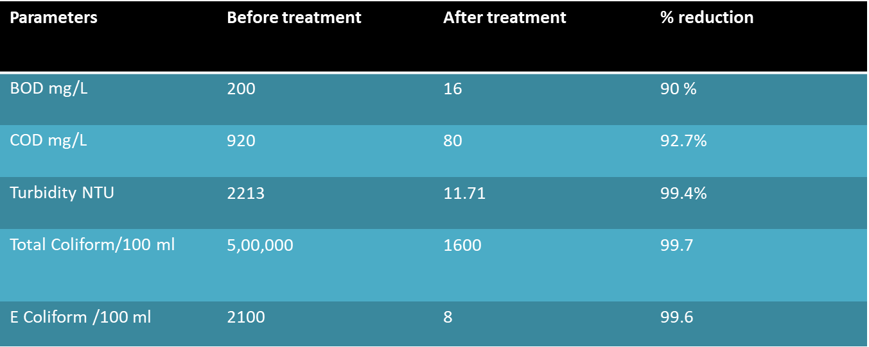
Reduction in Pollution Parameters in 3 weeks Mainath , Aligarh
Drastic Reduction in 3-4 weeks

Slide 18

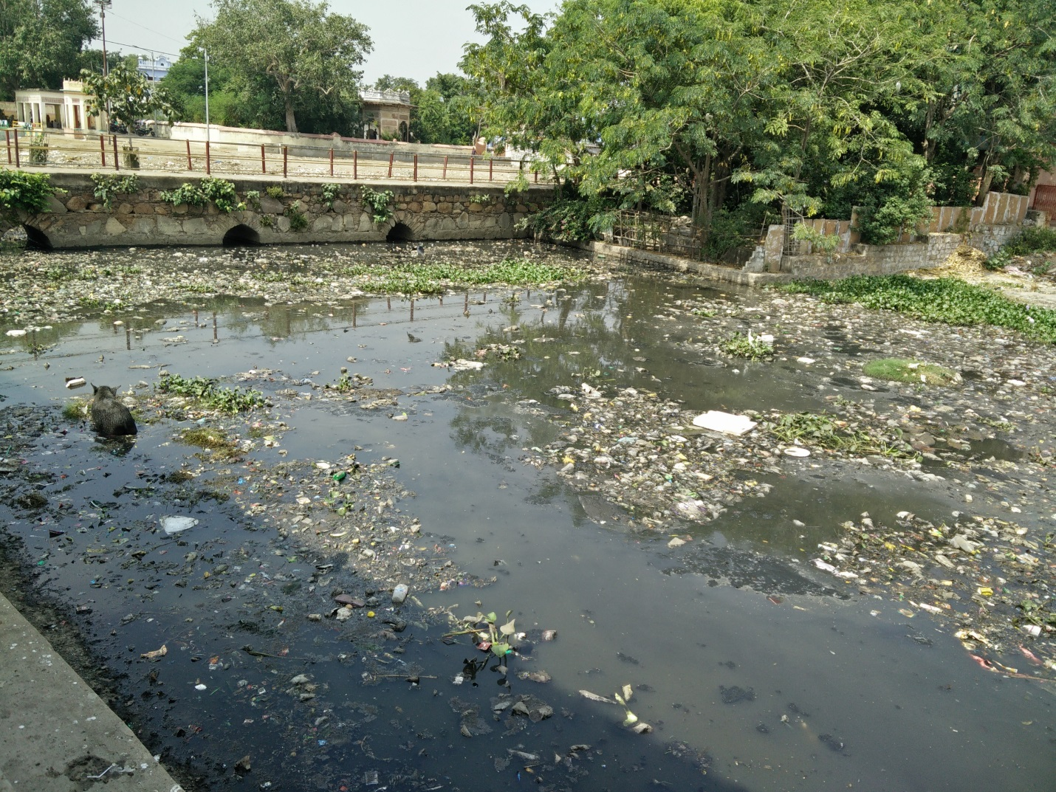
Treatment at Jhansi - Lakshmi taal

Slide 19

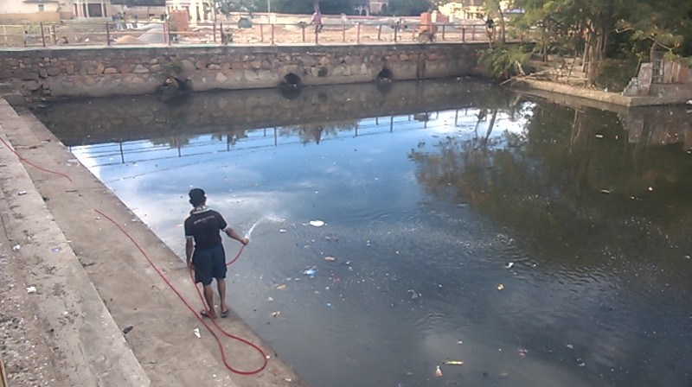
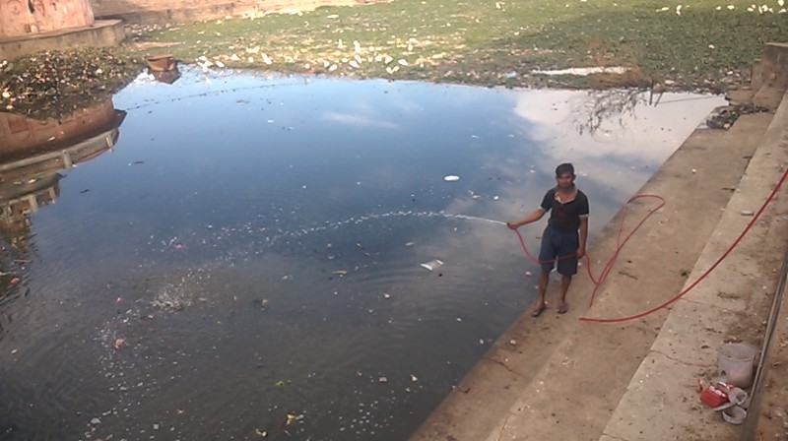
Jhansi – Lakshmi Talab after 3 weeks of treatment

Slide 20
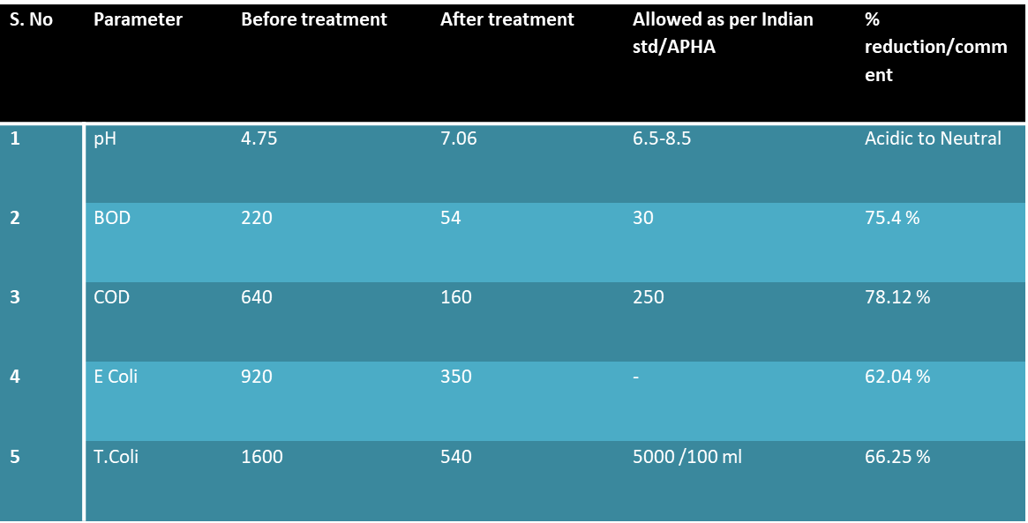
Results of Final treatment

Slide 21
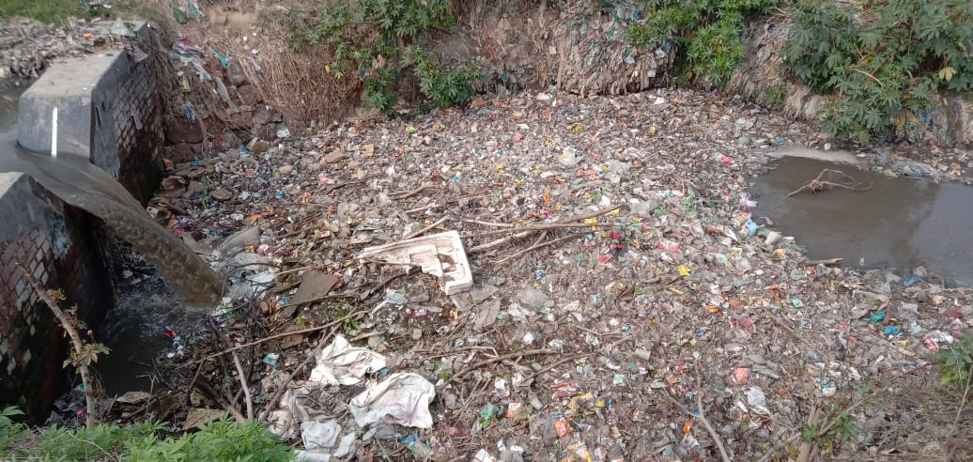
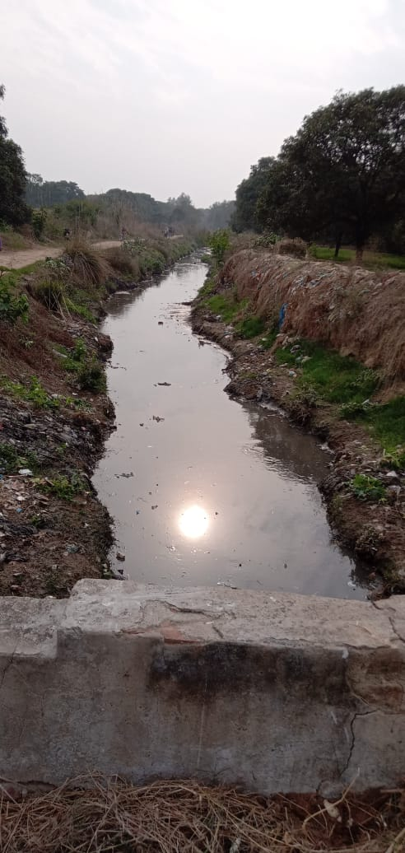
Our Project “WATER FOR LIFE” at Gulaothi
TREATED GULAOTHI DRAIN

Slide 22
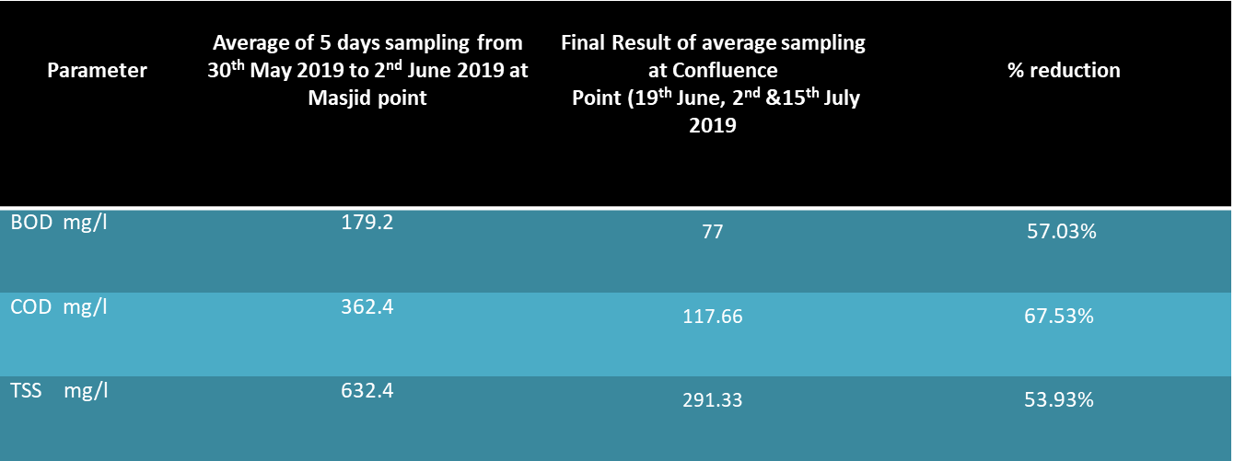
RESULTS of Gulaothi Drain

Slide 23

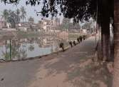
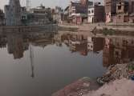
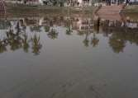
TREATMENT OF DHARAMSHALA POND, PUPRI,
SITAMARHI, BIHAR
Condition Before
Final condition of the Pond

Slide 24

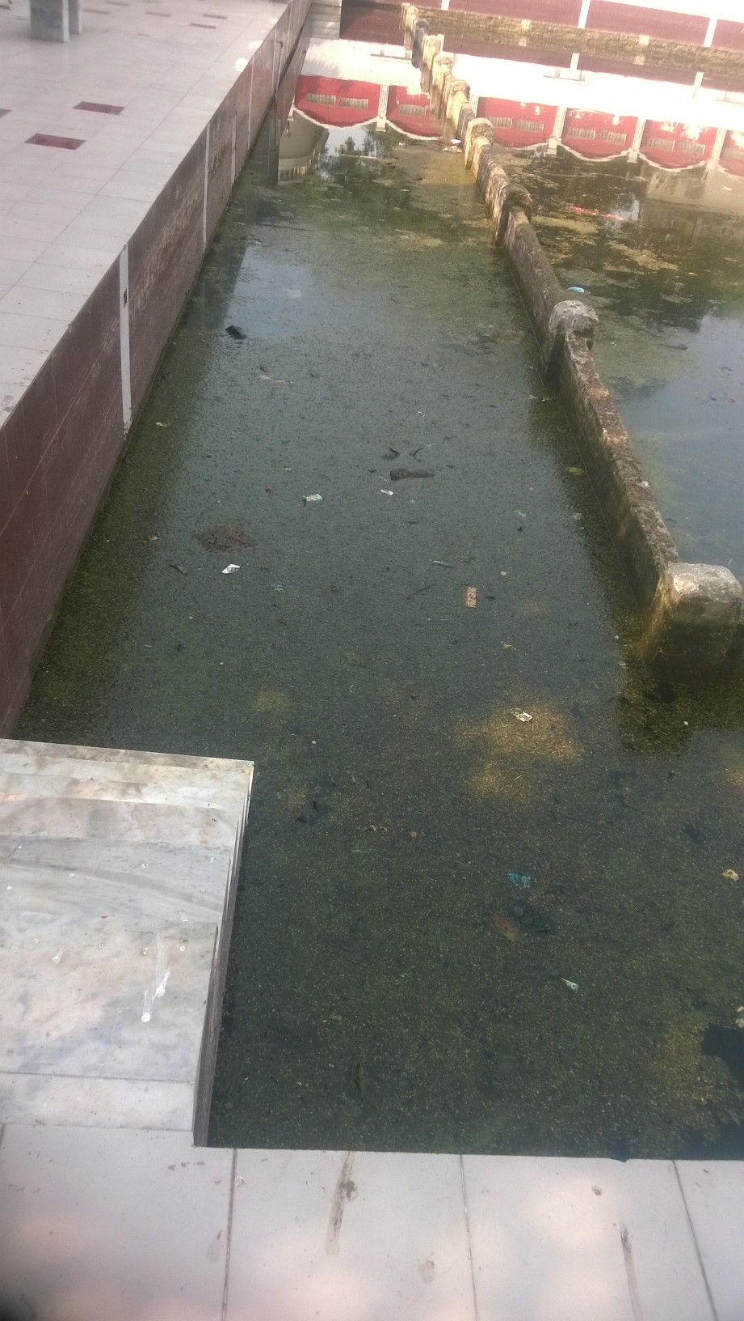
Treatment of Janki Pond at Sitamarhi , Bihar

Slide 25

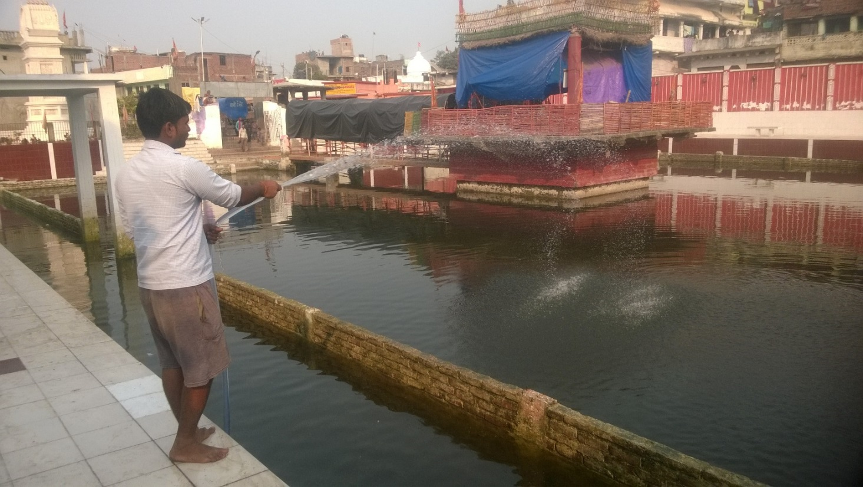
Janki Pond SITAMARHI Treated

Slide 26
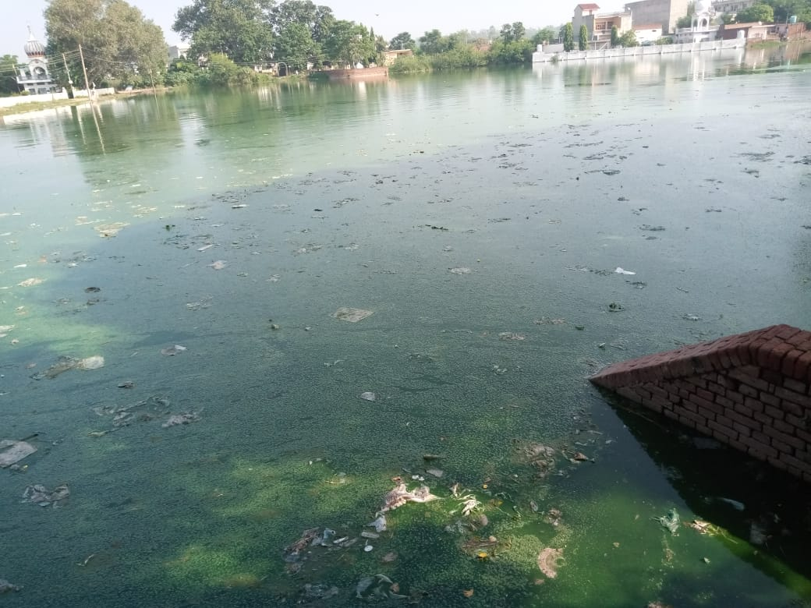
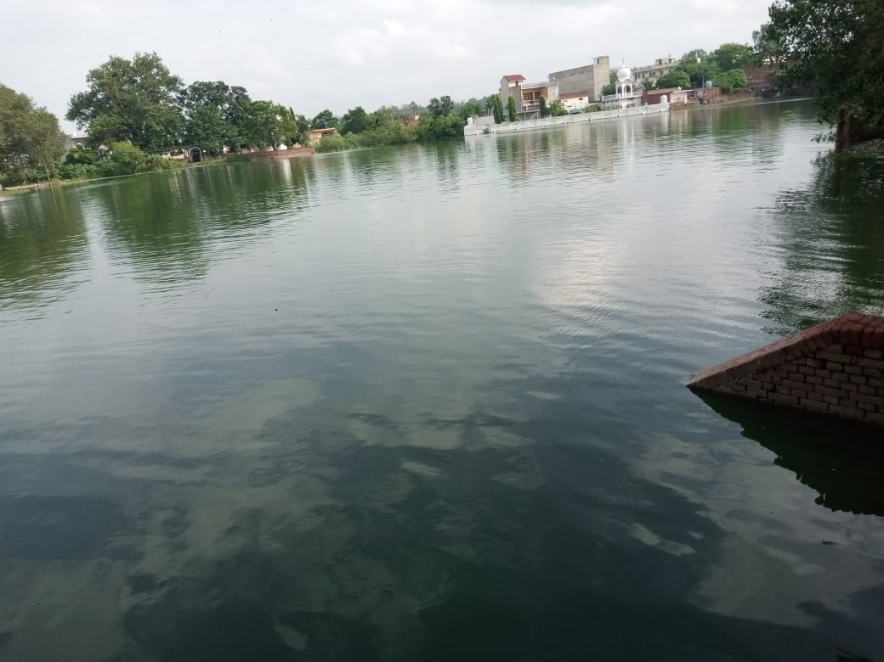
“WATER FOR LIFE” PROJECT IN PUNJAB
BEFORE
AFTER
5 ACRES POND

Slide 27
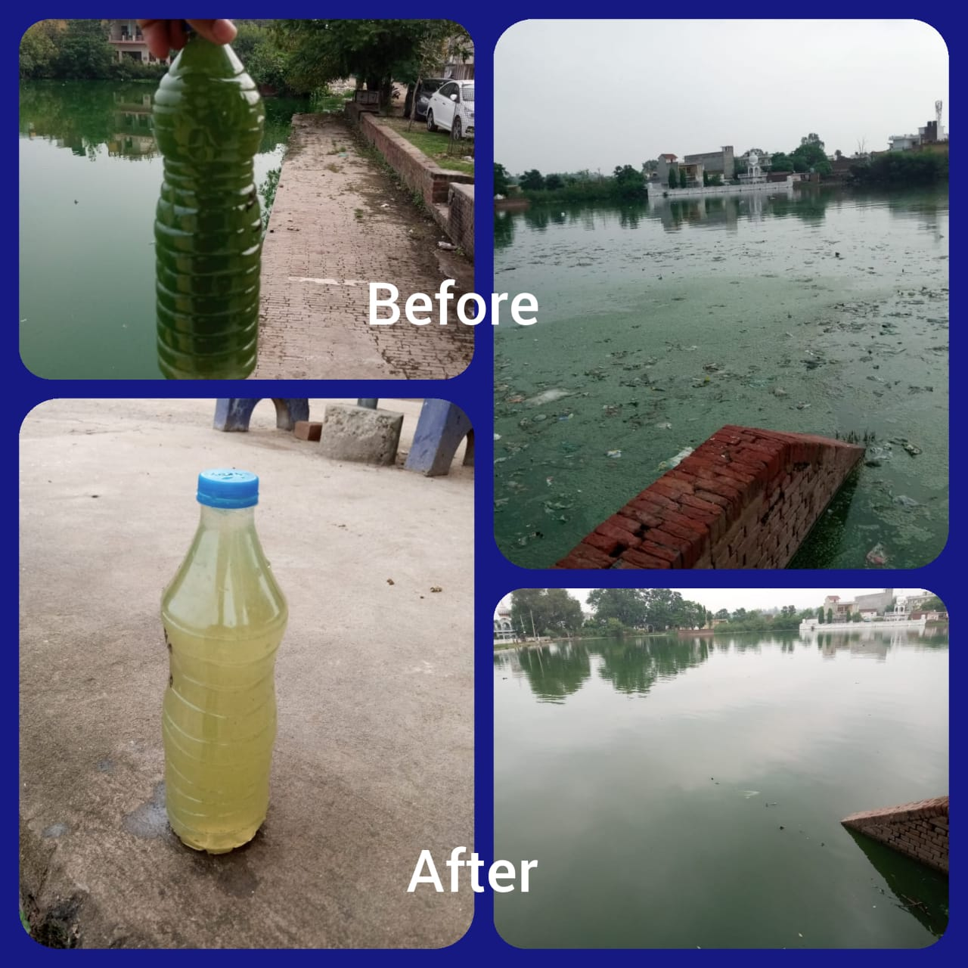
PROJECT “WATER FOR LIFE” IN PUNJAB

Slide 28
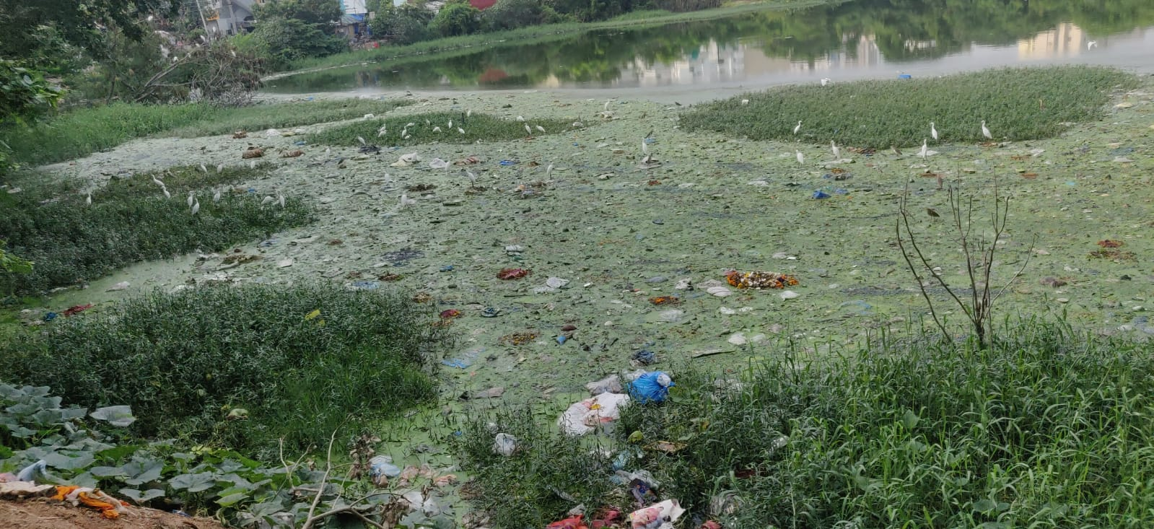
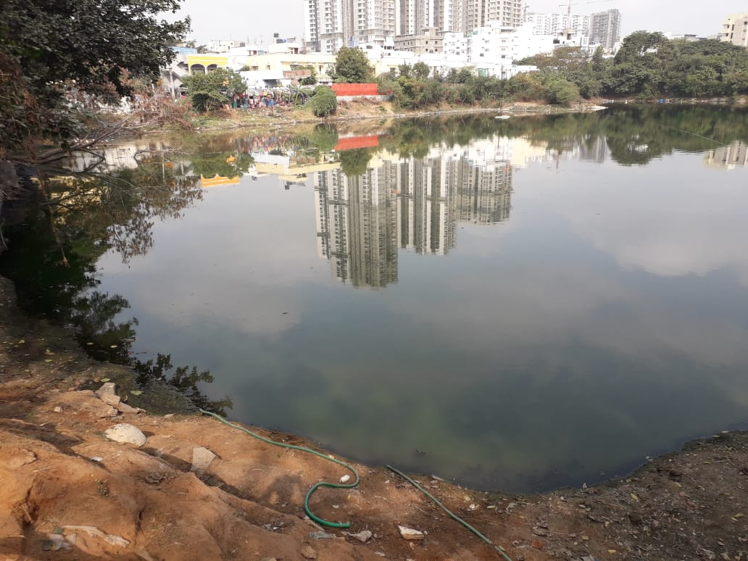
HYDERABAD SHAIKPET POND
BEFORE
AFTER

Slide 29

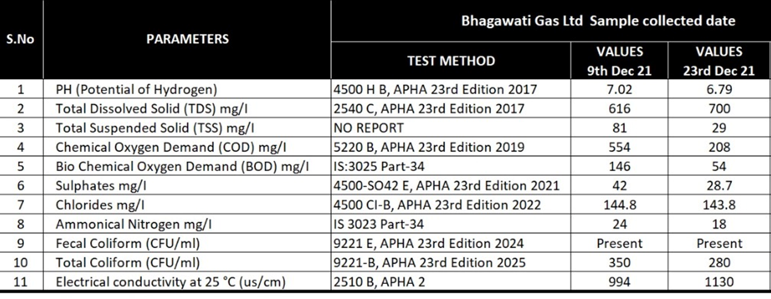
TEST RESULTS

Slide 30
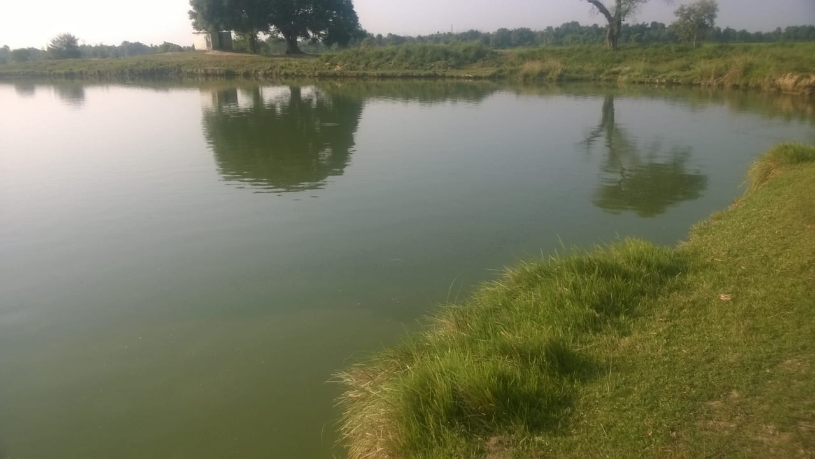
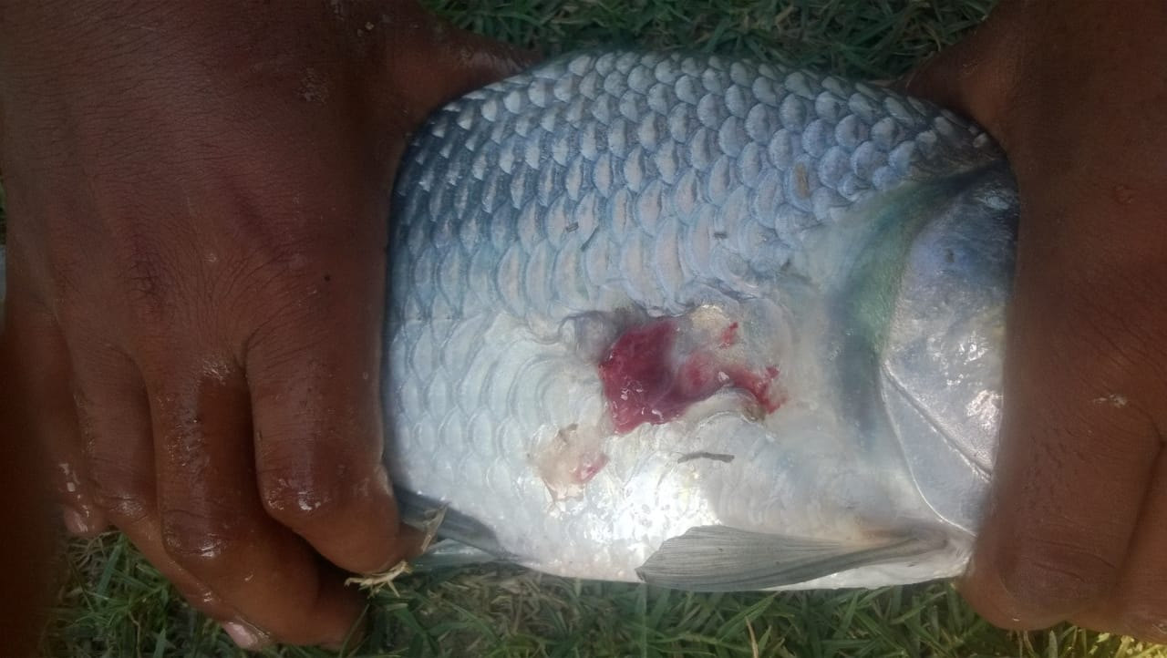
Pond was acidic with low dissolved oxygen
There was problem of Dying of Fishes
Condition of the pond was such that it was smelling and pH was 4.0

Slide 31

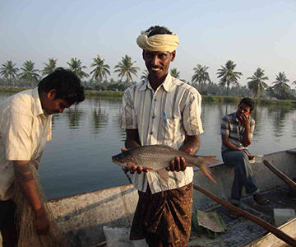
Algae helps to grow Fish without Changing Water in Fish Pond
Algae Fish are hygienic , organic and no smell because of Zoo-planktons . Phytoremediation takes care of self cleaning of Water

Slide 32

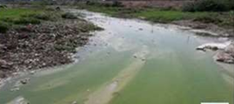
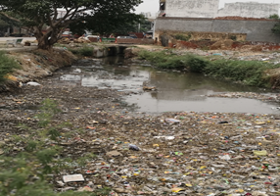

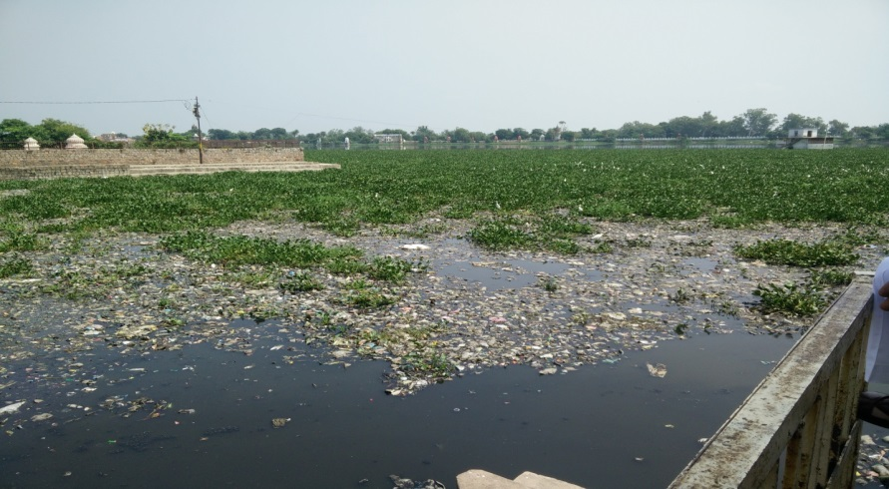
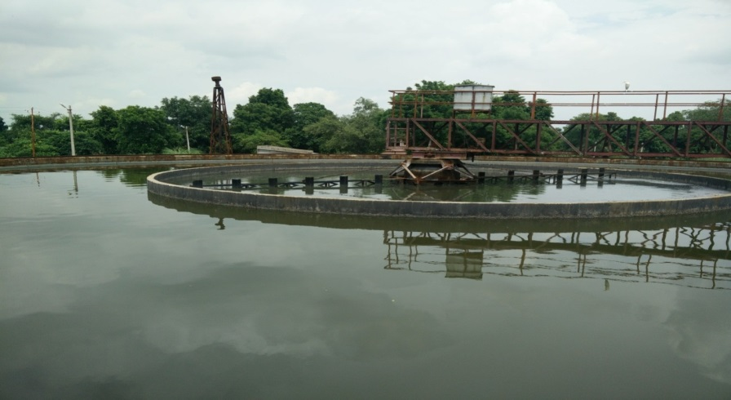
RIVERS
DRAINS
PONDS/LAKES
LAKES
STP/ETP

Slide 33
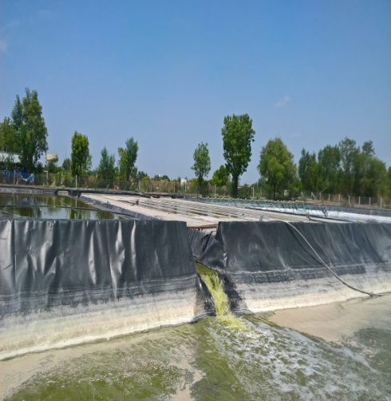
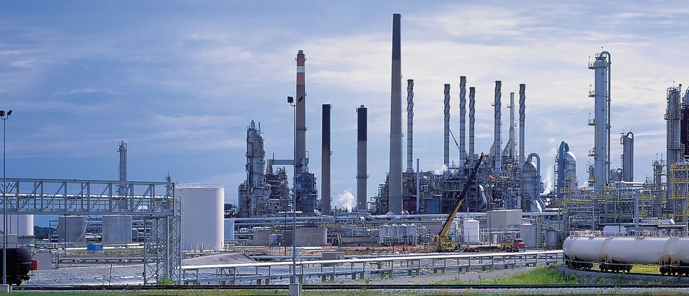
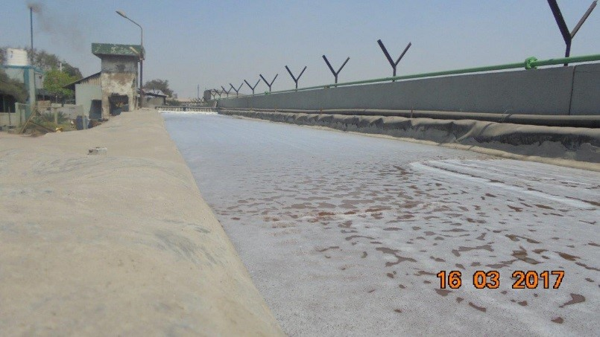
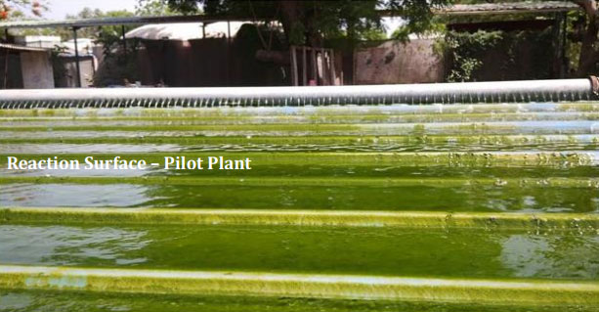
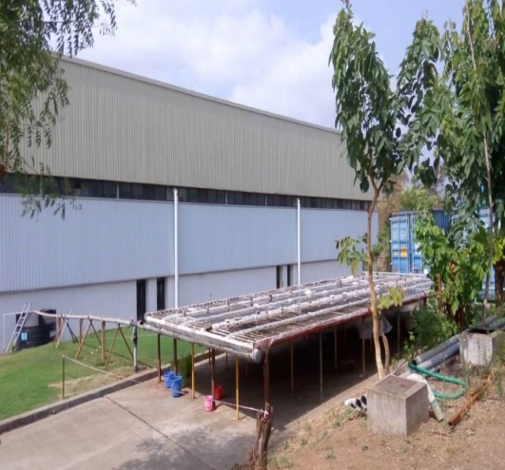
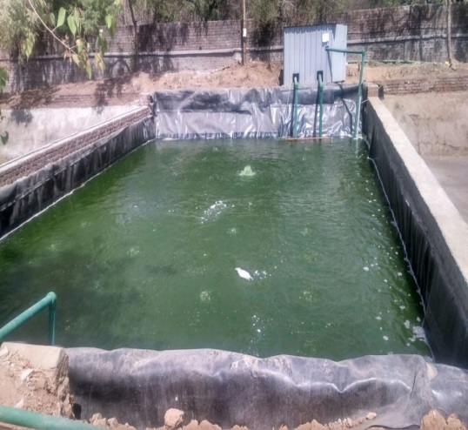
YUTI TEXTILES
KH LEATHER -CHENNAI
GUJARAT AGROCHEM
BRINTON CARPETS
HETTICH INDIA
ATUL LTD

Slide 34
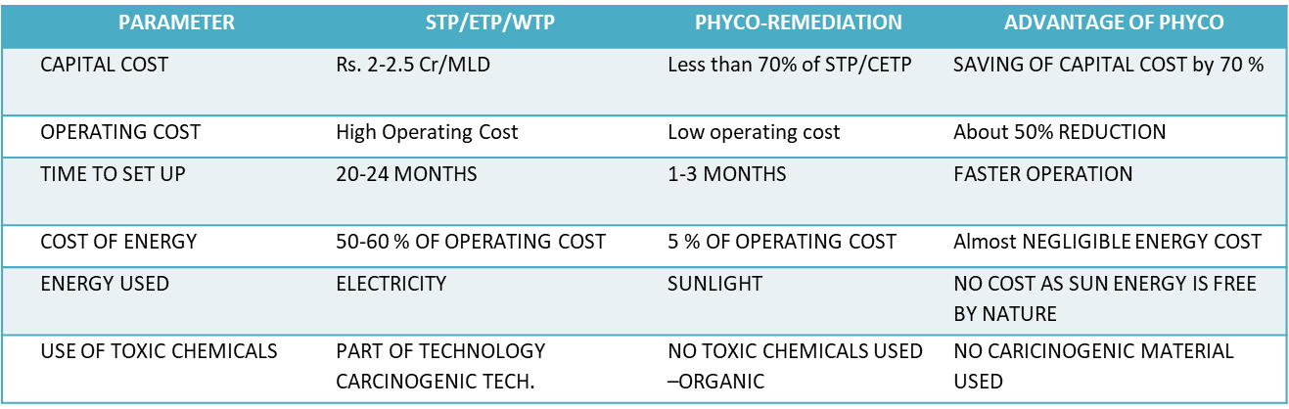
Comparison of Phytoremediation Vs STP

Slide 35
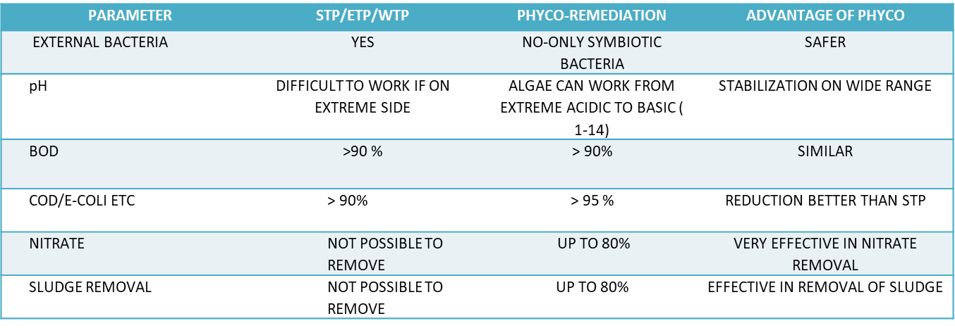
Comparison of Phytoremediation Vs STP

Slide 36
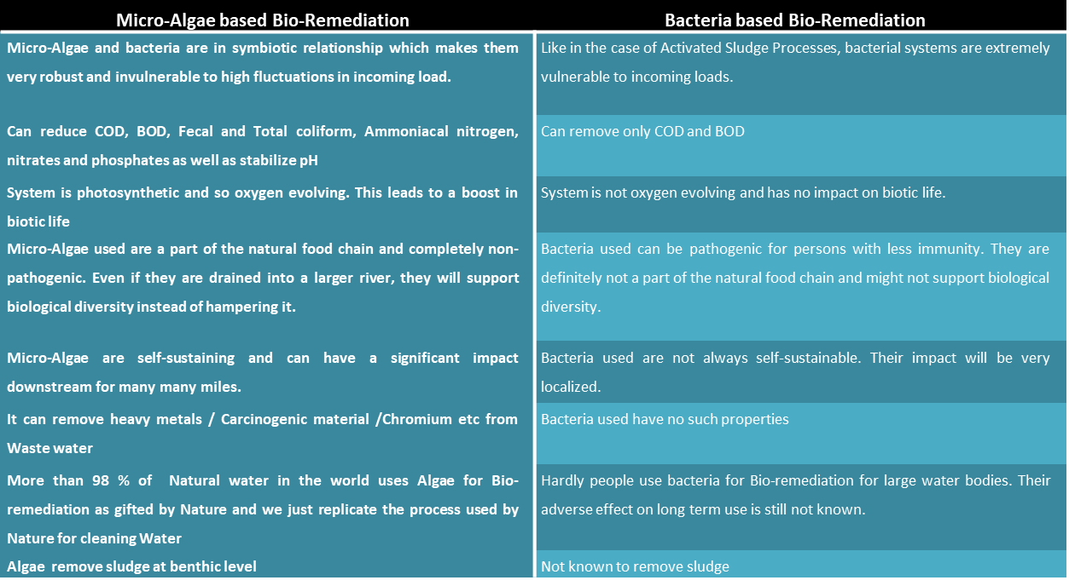
Why Phytoremediation is better than Bacteria based treatment

Slide 37
Social benefits –Using Phycoremediation
Due to Bio-oxygenation Mosquitos will be reduced by more than 50 %
100% removal of Toxic Gases & Stinking smell from polluted water. Environment will be Oxygen Rich
Animals and Birds will start drinking Water
Water weeds/water hyacinth growth will stop and removed naturally
Promotes bio-life like Fish, may be source of additional income to villagers
Improvement in Quality & Yield of farm produce using treated water farmers may need not use chemical/inorganic fertilizer
Improvement in Ground water quality over a period
Technology is very safe for human beings
Sustainable Technology due to Low capital cost & very low maintenance cost . Very easy to implement locally.

Slide 38

Thank You

